Slide 1

Balancing the Game: Comparative Analysis of Single Heuristics and Adaptive Heuristic Approaches for Sports Scheduling Problem
Seyed Erfan Alesahebfosoul
Supervisor: Ahmad Hemmati

Slide 2

Agenda:
Introduction and Background
Problem description
Solution approach
Experimental results
Conclusion and Future Works

Slide 3

Combinatorial Optimization Problems
Optimization problems
Finitely many possible options
Discrete decision variables
Examples: Knapsack, Traveling salesperson problem
Notes:
finding the best possible solution from a finite set of possible options discrete decision variables

Slide 4

Sports Scheduling problem
COP
Which
When
Where
Examples: Round-robin tournaments Elimination tournaments Hybrid tournaments
Notes:
the creation of a schedule that specifies the opponents, timing, and venues of all teams’ matches.
A round-robin tournament is a tournament in which each participant plays every other participant the same number of times, usually once or twice
Elimination tournaments are a tournament where participants are paired up and play against each other in a single game or a series of games. The winner advances to the next round, while the loser is eliminated.
Hybrid: A combination of round-robin and elimination formats

Slide 5

Terminology
Double round robin (2RR)
Compact/Relaxed
Home game/Away game/ Bye
Break
Phased/Unphased
Notes:
Every team faces each other twice, even number of competitors
N team (even) -> at least n-1
Compact: number of slots available is the lower bound
Relaxed: more slots available -> here compact
Venues: team plays at its designated venue-> home, any other venue-> away, no game -> bye
Break: two games consecutively either at home or away
In a phased tournament, the schedule is divided into two halves. Each half forms its single round-robin tournament

Slide 6

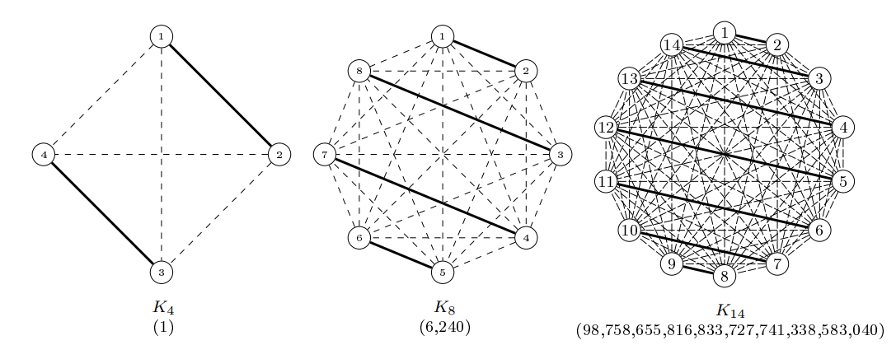
Challenge?
Stakeholders
Competition format
Vast solution space
Figure: David Van Bulck. Sports timetabling: theoretical results and new insights in algorithm performance (PhD dissertation). PhD thesis, September 2020
Notes:
Stakeholders: Clubs, broadcasters, government

Slide 7
Challenge?
Stakeholders
Competition format
Vast solution space
Figure: David Van Bulck. Sports timetabling: theoretical results and new insights in algorithm performance (PhD dissertation). PhD thesis, September 2020
Notes:
Stakeholders: Clubs, broadcasters, government

Slide 8
Challenge?
Stakeholders
Competition format
Vast solution space
NP-hard
Figure: David Van Bulck. Sports timetabling: theoretical results and new insights in algorithm performance (PhD dissertation). PhD thesis, September 2020
Notes:
Stakeholders: Clubs, broadcasters, government

Slide 9
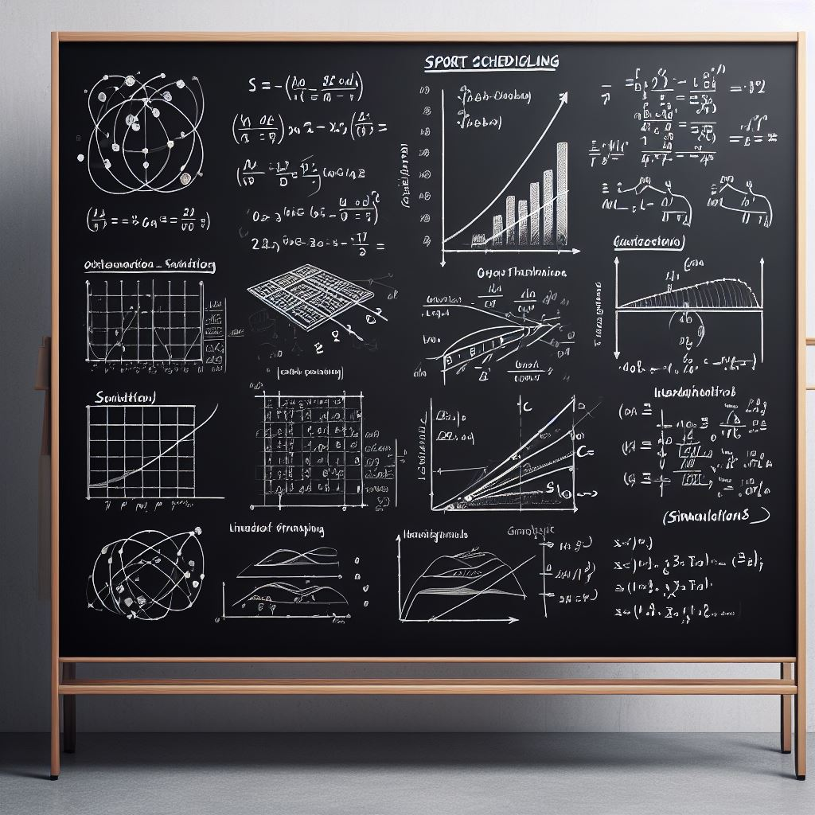
Solution methods:
Exact
Heuristic
Metaheuristic
Matheuristic
Notes:
Exact: guarantee to find the optimal solution or prove its nonexistence. are usually very efficient for small and medium-sized instances of simple COPs, but they may become impractical for large and complex problems due to the exponential growth of the search space
Heuristic: prioritize finding a good solution within a reasonable time frame rather than guaranteeing an optimal solution. Can get stuck in local optima
Meta: combine or adapt other heuristics to escape local optima and more efficiently explore the search space
Mat: combine mathematical programming techniques with heuristic methods, including metaheuristics. Aim to blend precision of mathematical programming with the speed and adaptability of heuristics

Slide 10

Related Works
International Timetabling Competition 2021
Fix and Optimize
Adaptive Large Neighborhood Search by Phillips et al.¹
A Fix-and-Optimize Heuristic by Fonseca et al. ²
Multi-Neighborhood Simulated Annealing by Rosati et al. ³
First-break-heuristically-schedule by Van Bulck et al. ⁴
1. Antony E. Phillips, Michael O’Sullivan, and Cameron Walker. An adaptive large neighbourhood search matheuristic for the ITC2021 Sports Timetabling Competition. In Proceedings of the 13th International Conference on the Practice and Theory of Automated Timetabling-PATAT, volume 2, 2021
2. George HG Fonseca and Tulio AM Toffolo. A fix-and-optimize heuristic for the ITC2021 sports timetabling problem. Journal of Scheduling, 25(3):273–286, 2022. ISBN: 1094-6136 Publisher: Springer.
3. Roberto Maria Rosati, Matteo Petris, Luca Di Gaspero, and Andrea Schaerf. Multineighborhood simulated annealing for the sports timetabling competition ITC2021. Journal of Scheduling, 25(3):301–319, 2022. ISBN: 1094-6136 Publisher: Springer.
4. David Van Bulck and Dries Goossens. First-break-heuristically-schedule: Constructing highly-constrained sports timetables. Operations Research Letters, 51(3):326–331, 2023. ISBN: 0167-6377 Publisher: Elsevier.
Notes:
International timetabling competition in 2021 was focused on the sports scheduling problem and the development of solution approaches for the construction of round-robin timetables
Participants in this competition have used various approaches to solve each instance. One frequently employed strategy, commonly known as the fix-and-optimize approach, falls under matheuristics. This strategy involves iteratively utilizing a mathematical programming solver to optimize a specific subset of variables while the remainder of the variables remain fixed.
Phillips ALNS + reinforcement learning + random selection from unsatisfied constraints
Fonseca: Fix & optimize only random selection of teams/slots to fix
Rosati: Metaheuristic, simulated annealing , no solver used
Van Bulck: home and away pattern then compatible opponent schedule by fix and optimize

Slide 11

Constraints
Hard: Cannot violate
Soft: Violate=penalty
Capacity constraints
Home/Away within given timeslots (4 types)
Game constraints
Mandate/Prohibit a game or set of games within given timeslots
Break constraints
Limit on number of breaks within given timeslots
Fairness constraints
Limit on difference between number of home games
Separation constraints
Lower limit on gap between games between same teams
Objective
Notes:
Cap: force a team to play home or away and regulate the total number of games played by a team or group of teams
Game: enforce or forbid specific assignments of a game to slots.
Break: regulate the frequency and timing of breaks in a competition
Fair: prevent an unbalanced timetable concerning home games, travel distances, etc.
Sep: regulate the number of rounds between consecutive games involving the same teams. Objective: minimize the total (weighted) sum of deviations resulting from violated soft constraints while respecting all hard constraints.

Slide 12
Constraints
S₁ | S₂ | S₃ | S₄ | S₅ | S₆ | S₇ | S₈ | S₉ | S₁₀
(1,2) | (2,5) | (2,4) | (2,3) | (6,2) | (4,2) | (5,2) | (2,1) | (3,2) | (2,6)
(3,4) | (4,1) | (1,6) | (5,1) | (4,5) | (6,1) | (1,4) | (4,3) | (1,5) | (5,4)
(5,6) | (6,3) | (5,3) | (6,4) | (1,3) | (3,5) | (3,6) | (6,5) | (4,6) | (3,1)
Hard: Cannot violate
Soft: Violate=penalty
Capacity constraints
Home/Away within given timeslots (4 types)
Game constraints
Mandate/Prohibit a game or set of games within given timeslots
Break constraints
Limit on number of breaks within given timeslots
Fairness constraints
Limit on difference between number of home games
Separation constraints
Lower limit on gap between games between same teams
<CA1 max="1" min="0" mode="H" penalty="1" slots= "10;7;8" teams= "2" type="HARD"/>
Notes:
Team 2 can only play at most 1 Home game during slots 7 8 and 10 -> violated

Slide 13
Constraints
S₁ | S₂ | S₃ | S₄ | S₅ | S₆ | S₇ | S₈ | S₉ | S₁₀
(1,2) | (2,5) | (2,4) | (2,3) | (6,2) | (4,2) | (5,2) | (2,1) | (3,2) | (2,6)
(3,4) | (4,1) | (1,6) | (5,1) | (4,5) | (6,1) | (1,4) | (4,3) | (1,5) | (5,4)
(5,6) | (6,3) | (5,3) | (6,4) | (1,3) | (3,5) | (3,6) | (6,5) | (4,6) | (3,1)
Hard: Cannot violate
Soft: Violate=penalty
Capacity constraints
Home/Away within given timeslots (4 types)
Game constraints
Mandate/Prohibit a game or set of games within given timeslots
Break constraints
Limit on number of breaks within given timeslots
Fairness constraints
Limit on difference between number of home games
Separation constraints
Lower limit on gap between games between same teams
<GA1 max="3" meetings=“1,5;3,4;6,4;" min="1" penalty="1" slots=“10;4;2" type="SOFT"/>
Notes:
At least 1 and at most 3 games from (1,5), (3,4) and (6,4) can take place during slots 2,4 and 10 -> Soft but not violated -> no penalty

Slide 14
Constraints
S₁ | S₂ | S₃ | S₄ | S₅ | S₆ | S₇ | S₈ | S₉ | S₁₀
(1,2) | (2,5) | (2,4) | (2,3) | (6,2) | (4,2) | (5,2) | (2,1) | (3,2) | (2,6)
(3,4) | (4,1) | (1,6) | (5,1) | (4,5) | (6,1) | (1,4) | (4,3) | (1,5) | (5,4)
(5,6) | (6,3) | (5,3) | (6,4) | (1,3) | (3,5) | (3,6) | (6,5) | (4,6) | (3,1)
Hard: Cannot violate
Soft: Violate=penalty
H
A
Capacity constraints
Home/Away within given timeslots (4 types)
Game constraints
Mandate/Prohibit a game or set of games within given timeslots
Break constraints
Limit on number of breaks within given timeslots
Fairness constraints
Limit on difference between number of home games
Separation constraints
Lower limit on gap between games between same teams
<BR1 intp="1" mode1="LEQ" mode2="HA" penalty="5" slots=“4;9;10" teams=“3" type="SOFT"/>
Notes:
Team 3 can have at most 1 break (home or away) during slots 4, 9 and 10. Soft and violated -> penalty

Slide 15
Constraints
S₁ | S₂ | S₃ | S₄ | S₅ | S₆ | S₇ | S₈ | S₉ | S₁₀
(1,2) | (2,5) | (2,4) | (2,3) | (6,2) | (4,2) | (5,2) | (2,1) | (3,2) | (2,6)
(3,4) | (4,1) | (1,6) | (5,1) | (4,5) | (6,1) | (1,4) | (4,3) | (1,5) | (5,4)
(5,6) | (6,3) | (5,3) | (6,4) | (1,3) | (3,5) | (3,6) | (6,5) | (4,6) | (3,1)
Hard: Cannot violate
Soft: Violate=penalty
Capacity constraints
Home/Away within given timeslots (4 types)
Game constraints
Mandate/Prohibit a game or set of games within given timeslots
Break constraints
Limit on number of breaks within given timeslots
Fairness constraints
Limit on difference between number of home games
Separation constraints
Lower limit on gap between games between same teams
T | S₁ | S₂ | S₃ | S₄ | S₅ | S₆ | S₇ | S₈ | S₉ | S₁₀
1 | 1 | 1 | 2 | 2 | 3 | 3 | 4 | 4 | 5 | 5
2 | 0 | 1 | 2 | 3 | 3 | 3 | 3 | 4 | 4 | 5
3 | 1 | 1 | 1 | 1 | 1 | 2 | 3 | 3 | 4 | 5
4 | 0 | 1 | 1 | 1 | 2 | 3 | 3 | 4 | 5 | 5
5 | 1 | 1 | 2 | 3 | 3 | 3 | 4 | 4 | 4 | 5
6 | 0 | 1 | 1 | 2 | 3 | 4 | 4 | 5 | 5 | 5
<FA2 intp="2" mode="H" penalty="10" slots="1;2;3;4;5;6;7;8;9;10" teams="1;6;5;2;3;4" type="SOFT"/>
Notes:
The difference in home games played between each pair of teams can not be larger than 1 during all the slots. Not violated -> no penalty

Slide 16
Constraints
S₁ | S₂ | S₃ | S₄ | S₅ | S₆ | S₇ | S₈ | S₉ | S₁₀
(1,2) | (2,5) | (2,4) | (2,3) | (6,2) | (4,2) | (5,2) | (2,1) | (3,2) | (2,6)
(3,4) | (4,1) | (1,6) | (5,1) | (4,5) | (6,1) | (1,4) | (4,3) | (1,5) | (5,4)
(5,6) | (6,3) | (5,3) | (6,4) | (1,3) | (3,5) | (3,6) | (6,5) | (4,6) | (3,1)
Hard: Cannot violate
Soft: Violate=penalty
Capacity constraints
Home/Away within given timeslots (4 types)
Game constraints
Mandate/Prohibit a game or set of games within given timeslots
Break constraints
Limit on number of breaks within given timeslots
Fairness constraints
Limit on difference between number of home games
Separation constraints
Lower limit on gap between games between same teams
<SE1 mode1="SLOTS" min=“3" penalty="10" teams="2;6;3;5;4;1" type="SOFT"/>
max(k - (s2 - s1 - 1); 0)
Notes:
There should be at least 4 time slots between the mutual games of team 0 and 1.

Slide 17
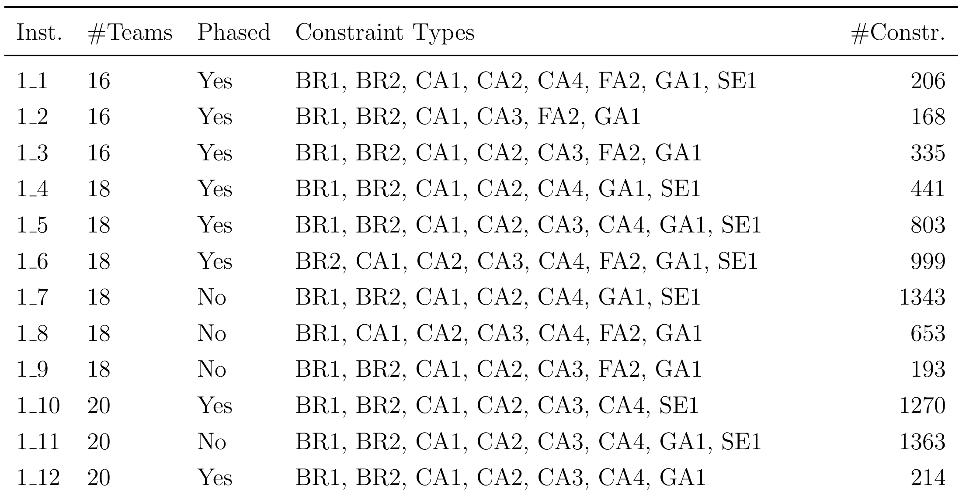
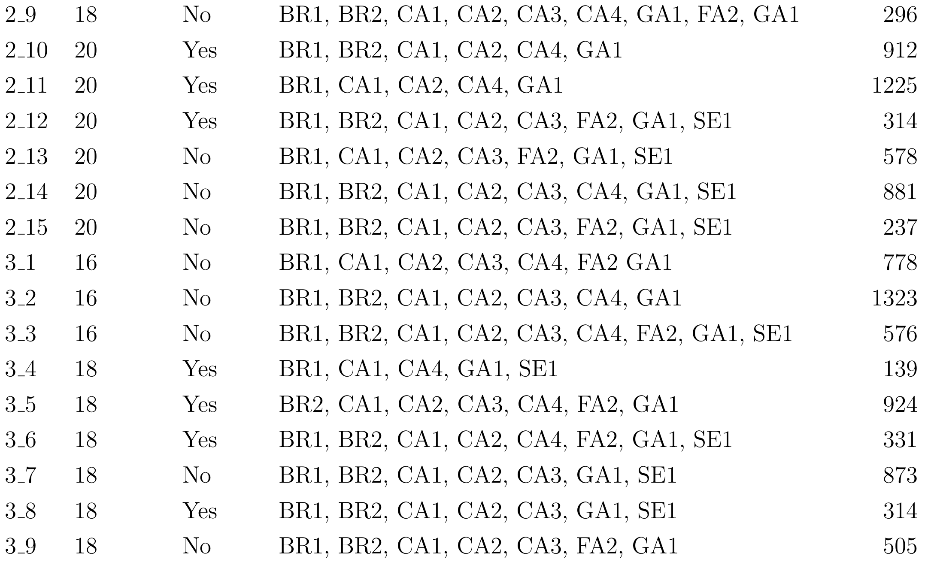
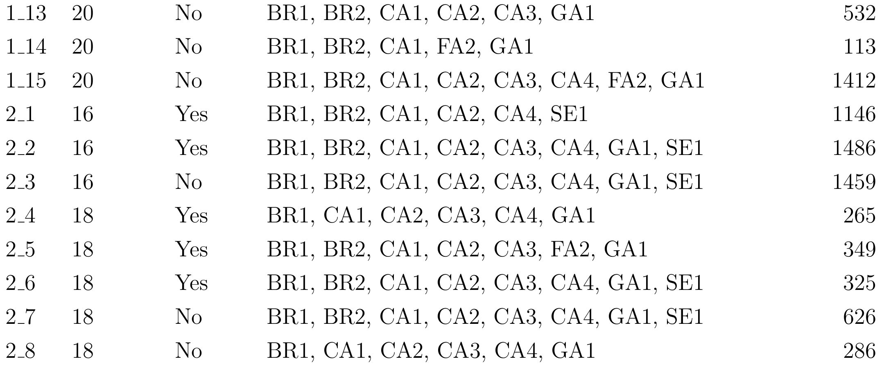
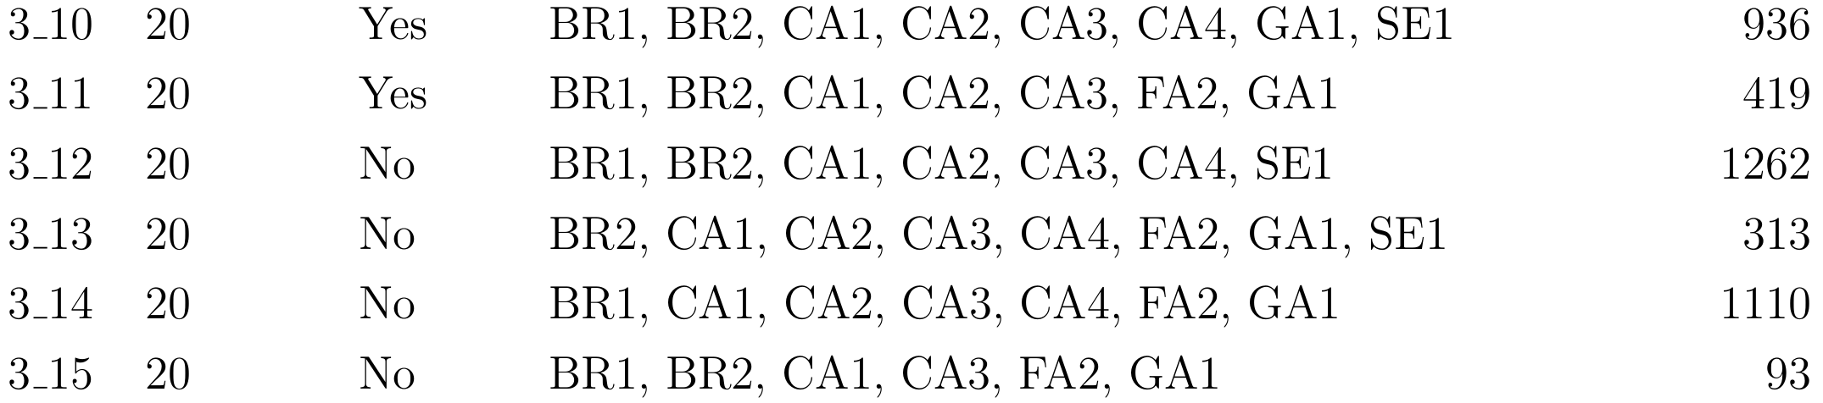
Instances Summary
Notes:
Total 45 instances
#teams 16 – 20
#constr: 93 -> 3_15 to 1486 -> 2_2
These instances were generated in three phases, which is reflected in their naming conventions

Slide 18

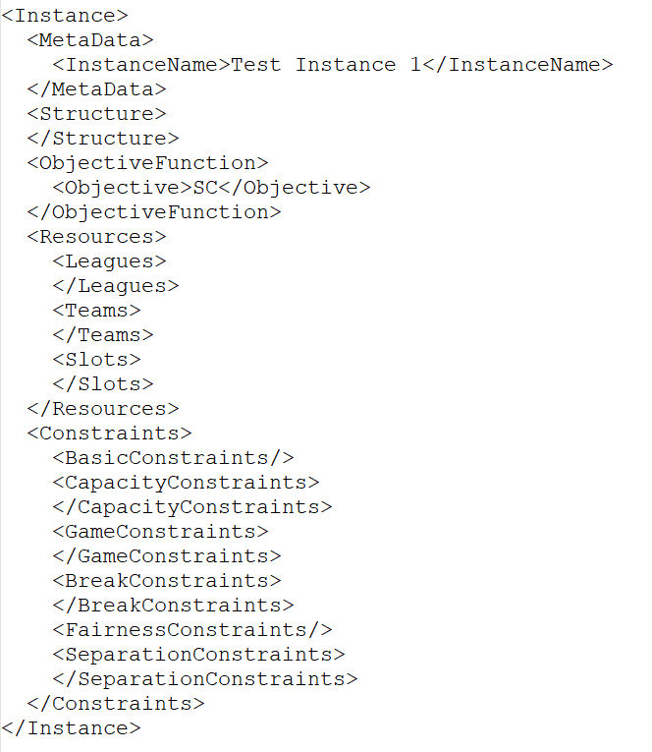
Implementation
Parse XML
Categorize constraints
Write Models for Gurobi
Notes:
Data was in XML format -> required to reorganize data into a format that aligns with solver requirements.
Implemented a code that automatically parses data, categorizes them by constraint types, and writes the instances in mathematical programing format

Slide 19

Obtaining initial solution
Primary model
Only hard constraints without objective
Hard constraints as soft constraints
Adaptive heuristic
Notes:
In addressing the diverse complexities of the instances, we have pursued various approaches to obtain feasible initial solutions. Each used on the ones without init_sol
1- Primary model (hard and soft constraint) with focus on finding feasible solutions
2- disregarding soft constraints and without objective function
3- treated hard constraints as soft constraints with objective of weighted sum of hard constraints. Goal -> reaching objective value 0
4- similar to 3 but using our adaptive heuristic method explained in further details in following

Slide 20
Improving solutions
Heuristics/neighborhoods
Slots
Teams
Neighborhood selection
Random
Costliest all
Costliest ones
Neighborhood size
Fix
Dynamic
Heuristic combinations
Single
Double
Adaptive
Notes:
Fix and optimize involved conducting neighborhood searches, allowing for the modification of a portion of the solution while keeping the remainder unchanged
- Choose a subset of slots/teams -> fix all variables except the ones associated to those slots/teams
Random selection -> diversification
Find all violated constraints. Check LHS.
Count number of times variables associated with teams and slots appeared on LHSs, weighted selection
Consider only the variables with value 1 -> most intensification
Fix or dynamic size
Predefined size and unchanged
Start from the same, increase by 1 if 10 consec iter ends in less than 60. decrease if timelimit reached
Combs
Single: 12 heuristic
Double: using both slots teams heuristics consecutively in each iter -> two new heur (random, large neighborhoods)
All single heuri available. Choose randomly, weight: based on performance in prev iters, update every 10 iter
Fix size
Dynamic large 300 seconds
Dynamic small 120 seconds

Slide 21

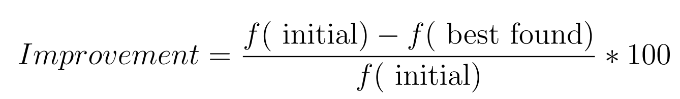
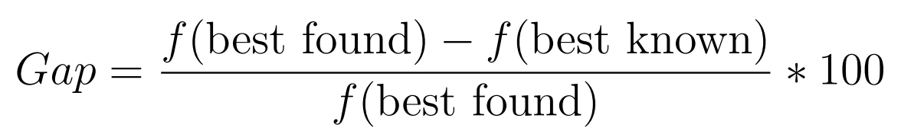
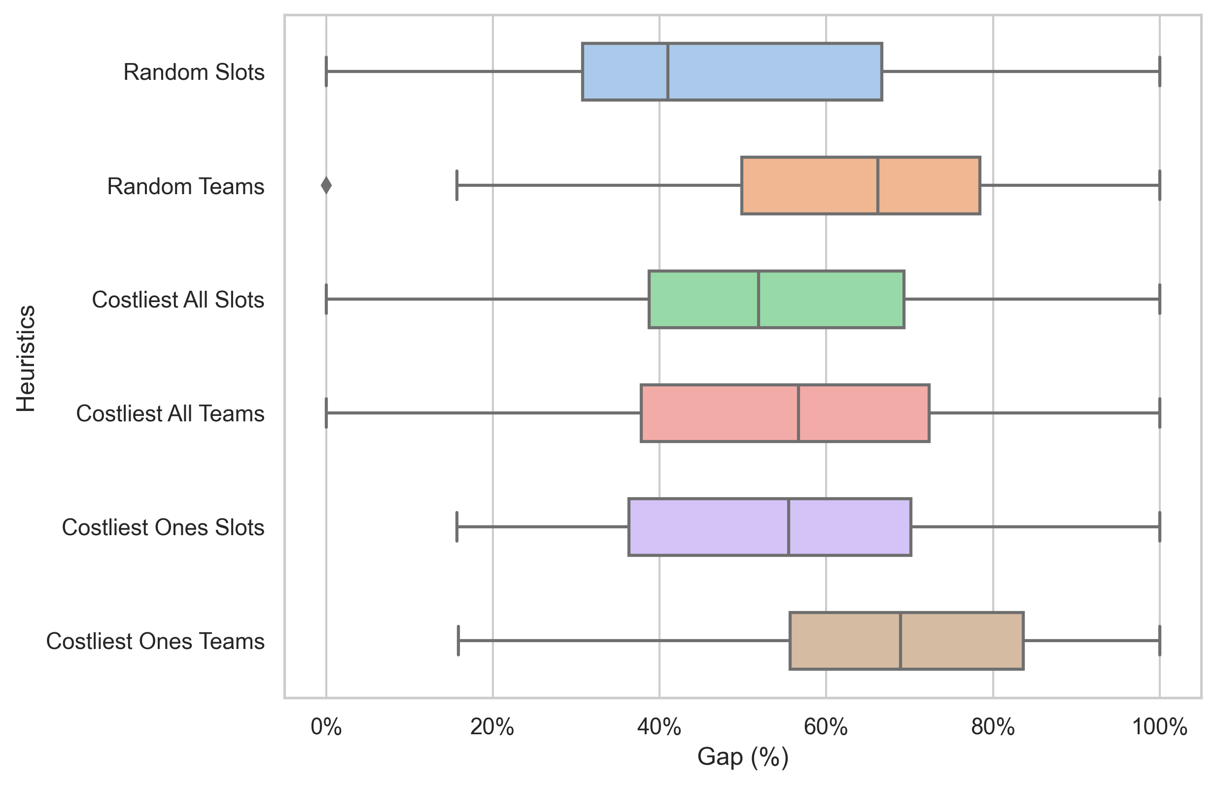
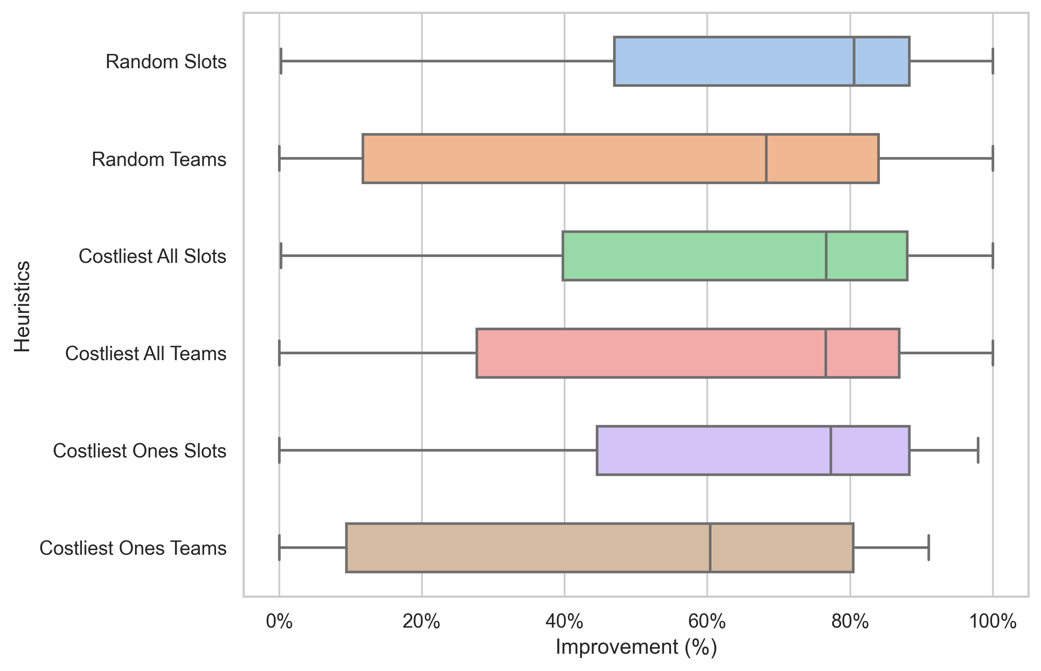
Experimental results
Initial solutions
Improving solutions
Single heuristic
Fixed size
Notes:
38 out of 45 instances, 32 no objective, 6 adaptive heuristic
Random Slots average Improvement of 67.88% and an average Gap of 48.04%
Costliest Ones Teams average Improvement of 49.81% an average Gap of 68.91%

Slide 22
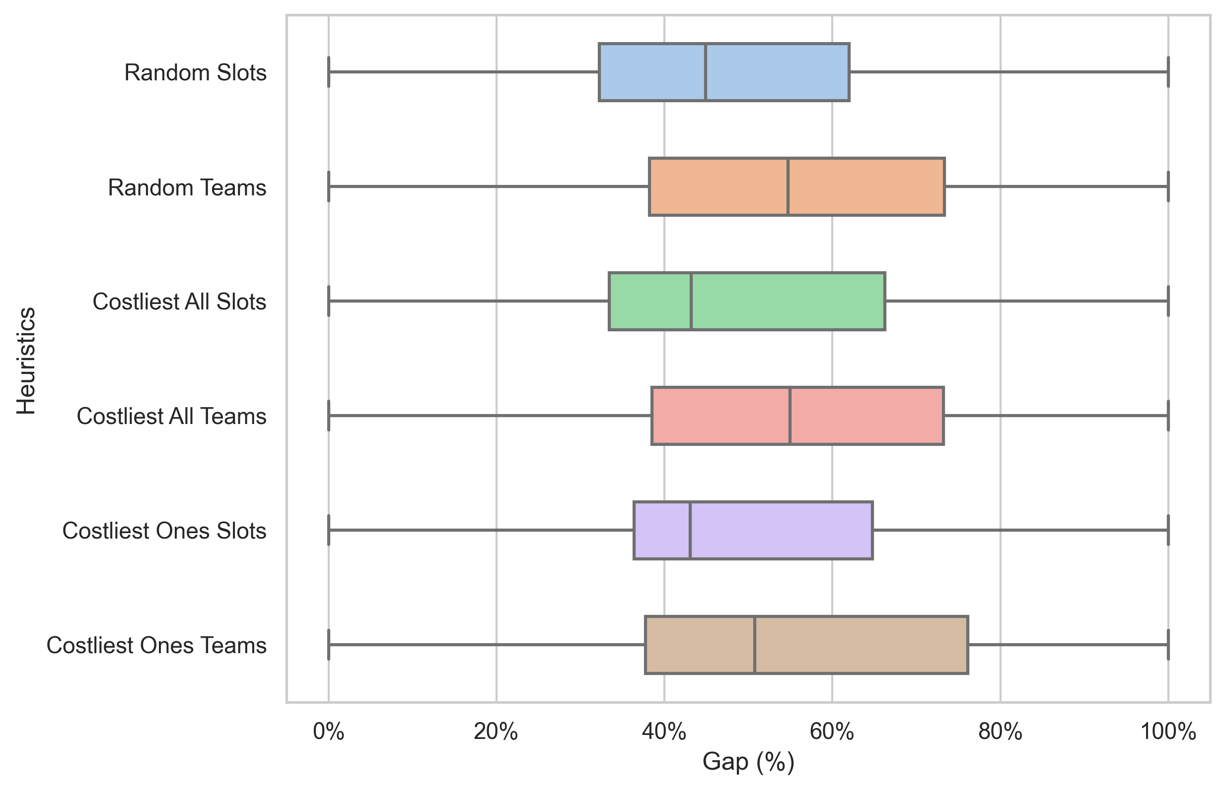
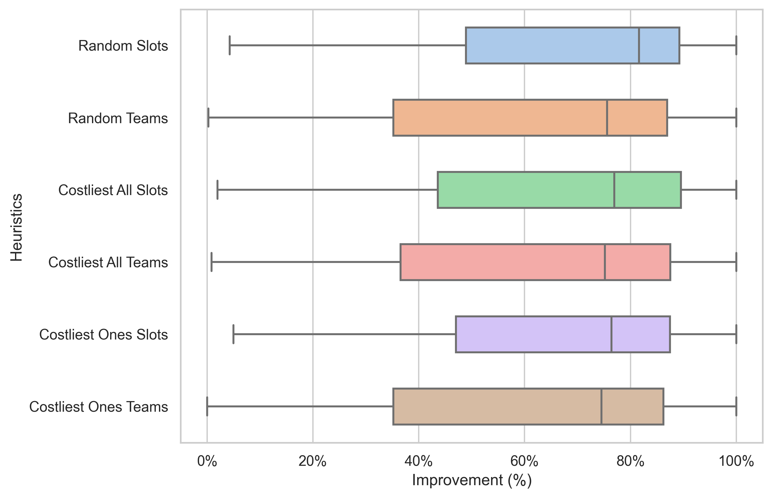
Experimental results
Initial solutions
Improving solutions
Single heuristic
Fixed size
Dynamic
Notes:
Random Slots average Improvement of 69.56% Gap, averaging 46.41%
Costliest Ones Teams an average Improvement of 62.14% average Gap of 55.64%

Slide 23
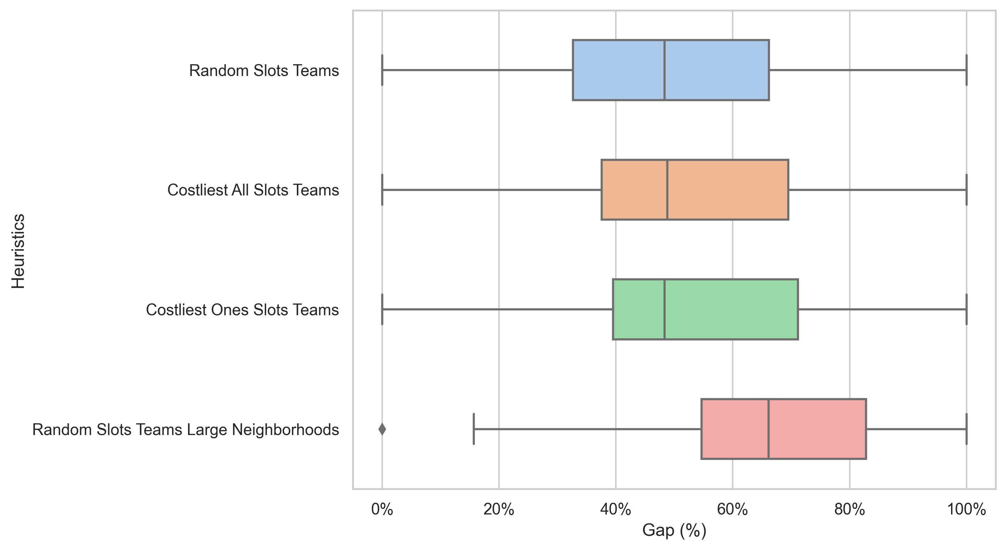
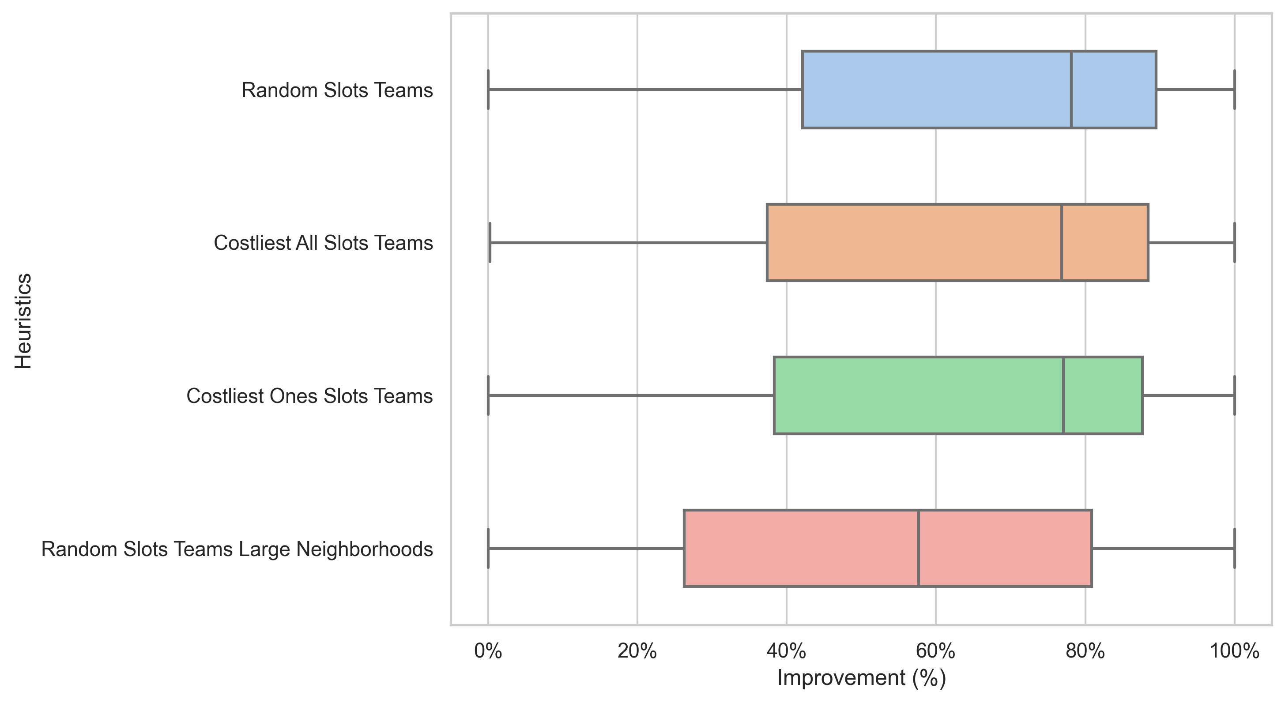
Experimental results
Initial solutions
Improving solutions
Single heuristic
Fixed size
Dynamic
Double heuristic
Notes:
random heuristics does not outperform the Random Slots heuristic alone.
Costliest Ones and Costliest All heuristics perform better than each of their respective single heuristics.
new heuristics do not yield promising results and exhibit the worst performance among all the double heuristics

Slide 24
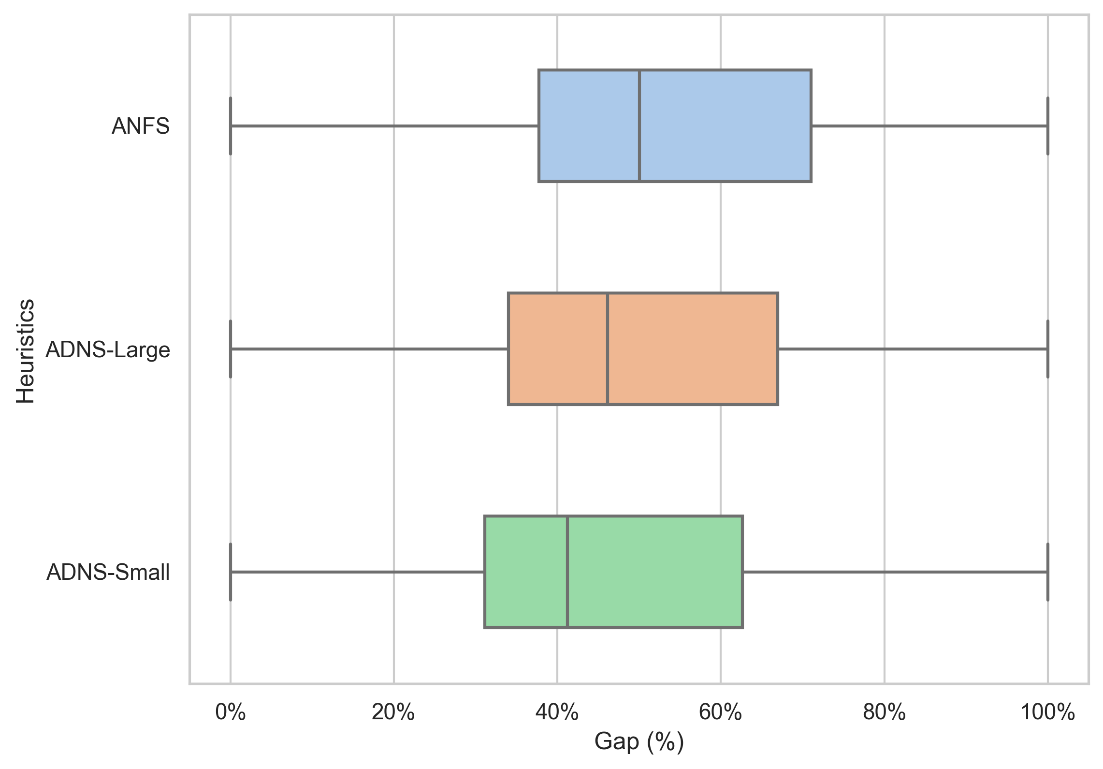
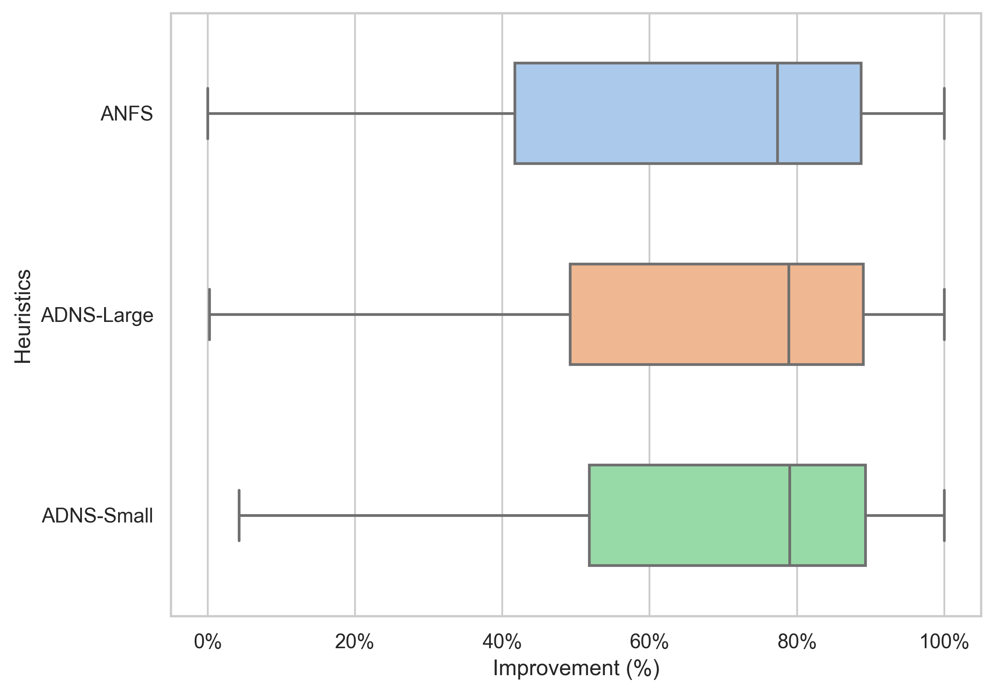
Experimental results
Initial solutions
Improving solutions
Single heuristic
Fixed size
Dynamic
Double heuristic
Adaptive heuristic
AFNS
ADNS-small
ADNS-large
Notes:
ADNS-Small achieves an average Improvement of 70.62% an average Gap of 45.23%

Slide 25
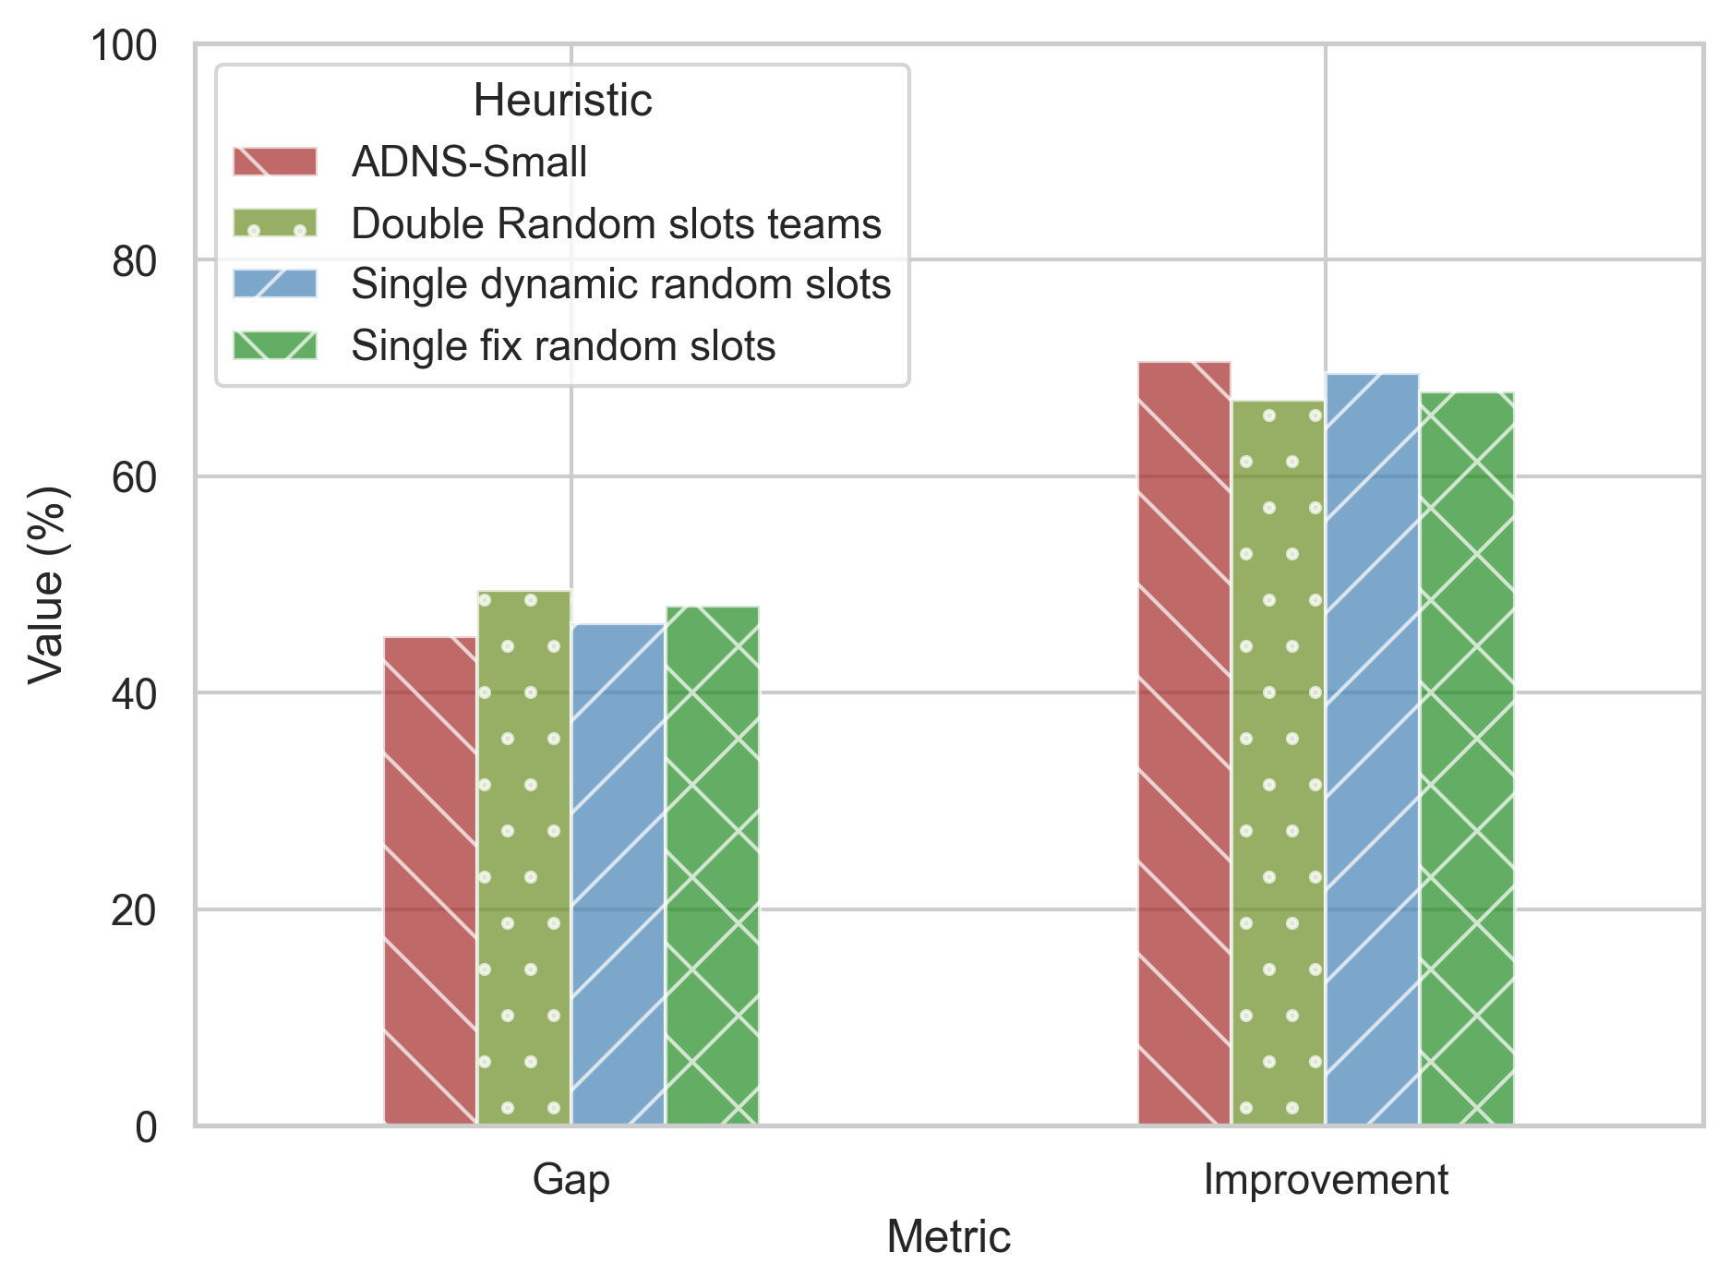
Conclusion and Future Works
Fix and Optimize
38 out of 45 instances
ADNS-Small approach outperformed all the other heuristics examined
Alternative strategies for dynamically adjusting neighborhood sizes
Different scoring systems
Explore and combine other existing heuristics from the literature
Develop and employ an escape heuristic

Slide 26

Thank you! Questions?

